Slide 1
Building Background: VOTING

Slide 2
What is a VOTE?
Notes:
Students will be given the opportunity to respond; answers could be things similar to: when you say what you want, giving your opinion on something, picking someone. It’s also possible that no student will know what a vote is, which is okay.

Slide 3
RAISE YOUR HAND → if you like doing MATH better than reading
Notes:
Okay, I’d like to know what you think about something. Raise your hand if you like doing MATH better than reading. (students will raise hands)

Slide 4
RAISE YOUR HAND → if you like READING better than doing MATH
Notes:
Raise your hand if you like reading better than doing math.

Slide 5
VOTED!
Notes:
You all just voted! Good job!

Slide 6
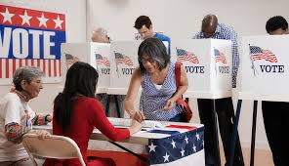
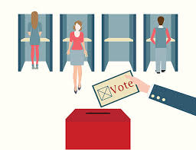
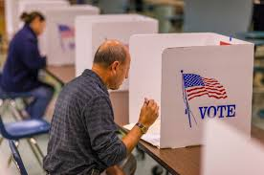
Notes:
Votes can happen at school (gesture around the room and point straight down at the floor) but they also happen for our whoooollle country. (point at map)

Slide 7
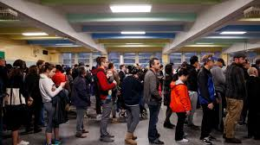
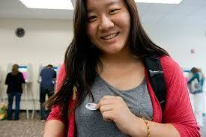
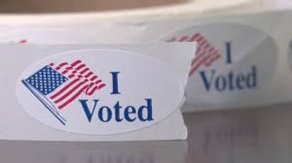
Notes:
Voting is important. People wait in long lines (point at line picture) to vote. People are proud (point at the face of the lady with sticker, then sticker) to vote.

Slide 8
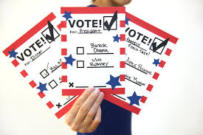
BALLOT
Notes:
You vote on a BALLOT. (point to picture) Can you say ballot? (Cup hand around ear, students will repeat word). A ballot is a piece of paper. (Hold up or point to a piece of paper.)

Slide 9
What is a CANDIDATE?
Notes:
People vote for a candidate. Can you say candidate? (Cup hand around ear, students will pronounce word). What is a candidate?
Possible answers: Someone who wants to be president, a guy who is on tv, an option

Slide 10
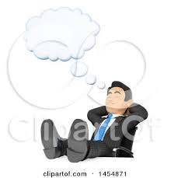
A CANDIDATE
wants people to vote for them.
Notes:
A CANDIDATE wants people to vote for them.

Slide 11
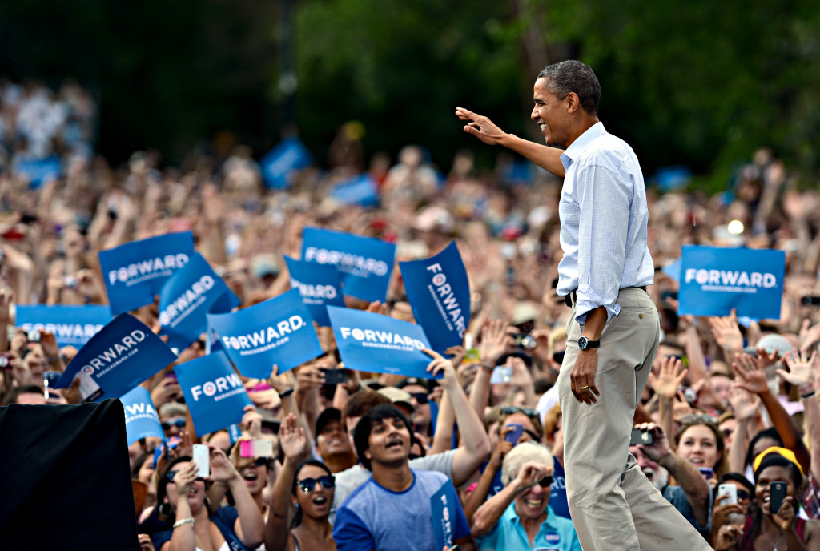
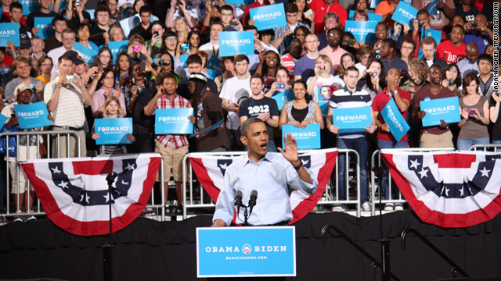
A candidate makes speeches to get people to vote for them.
Notes:
A candidate makes speeches to get people to vote for them. (Point to right picture on the word speeches.)

Slide 12
A CANDIDATE
wants people to vote for them.
build CONSENSUS
Notes:
A candidate wants people to vote for them. A candidate wants to BUILD CONSENSUS. Let’s say “BUILD CONSENSUS.” (Cup hand around ear, students will repeat)

Slide 13
building CONSENSUS
Notes:
Building consensus is asking people to vote for you. I (point to self) am building consensus.
Teacher will demonstrate building consensus by asking students to vote for her: (Point to student) “Will you vote for me?” (point to self). Repeat 3 or four times.

Slide 14
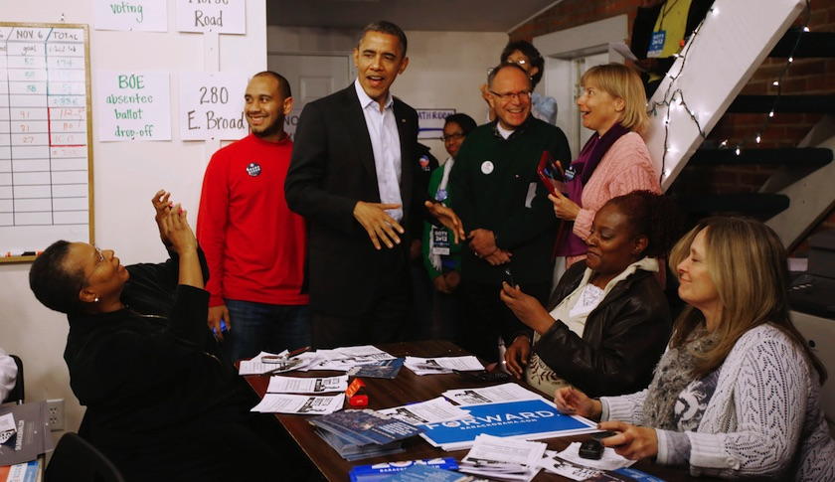
A candidate has a CAMPAIGN TEAM →
that helps him
build consensus.
Notes:
A candidate has a campaign team (point to picture, specifically to people circled) that helps him build consensus. Let’s read this together (cup hand around ear, students will say what’s on the slide with the teacher.)

Slide 15
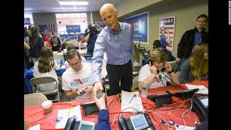
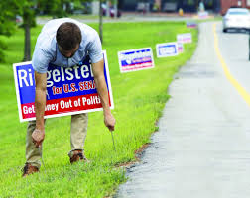
A CAMPAIGN TEAM asks people to vote for their candidate.
Notes:
A campaign team asks people to vote for their candidate. (point to the lady on the phones, point to man with sign)

Slide 16
Let’s try BUILDING CONSENSUS
Notes:
Let’s try building consensus. I (point to self) am a candidate. (Student name, pointing to student) you are my CAMPAIGN TEAM. Can you ask people to vote for me? (student should turn to another student and ask, “will you vote for (teacher)?” If not, teacher can say, “Say, (student 2), will you vote for (teacher name)?”

Slide 17
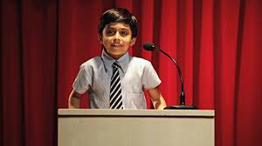
We are going to have a VOTE for CLASS PRESIDENT!
Notes:
Good job! We (gesture around the room) are going to have a VOTE for class president. (Teacher will introduce the activity; found in first Learning Activity on lesson plan.)

